Slide 1
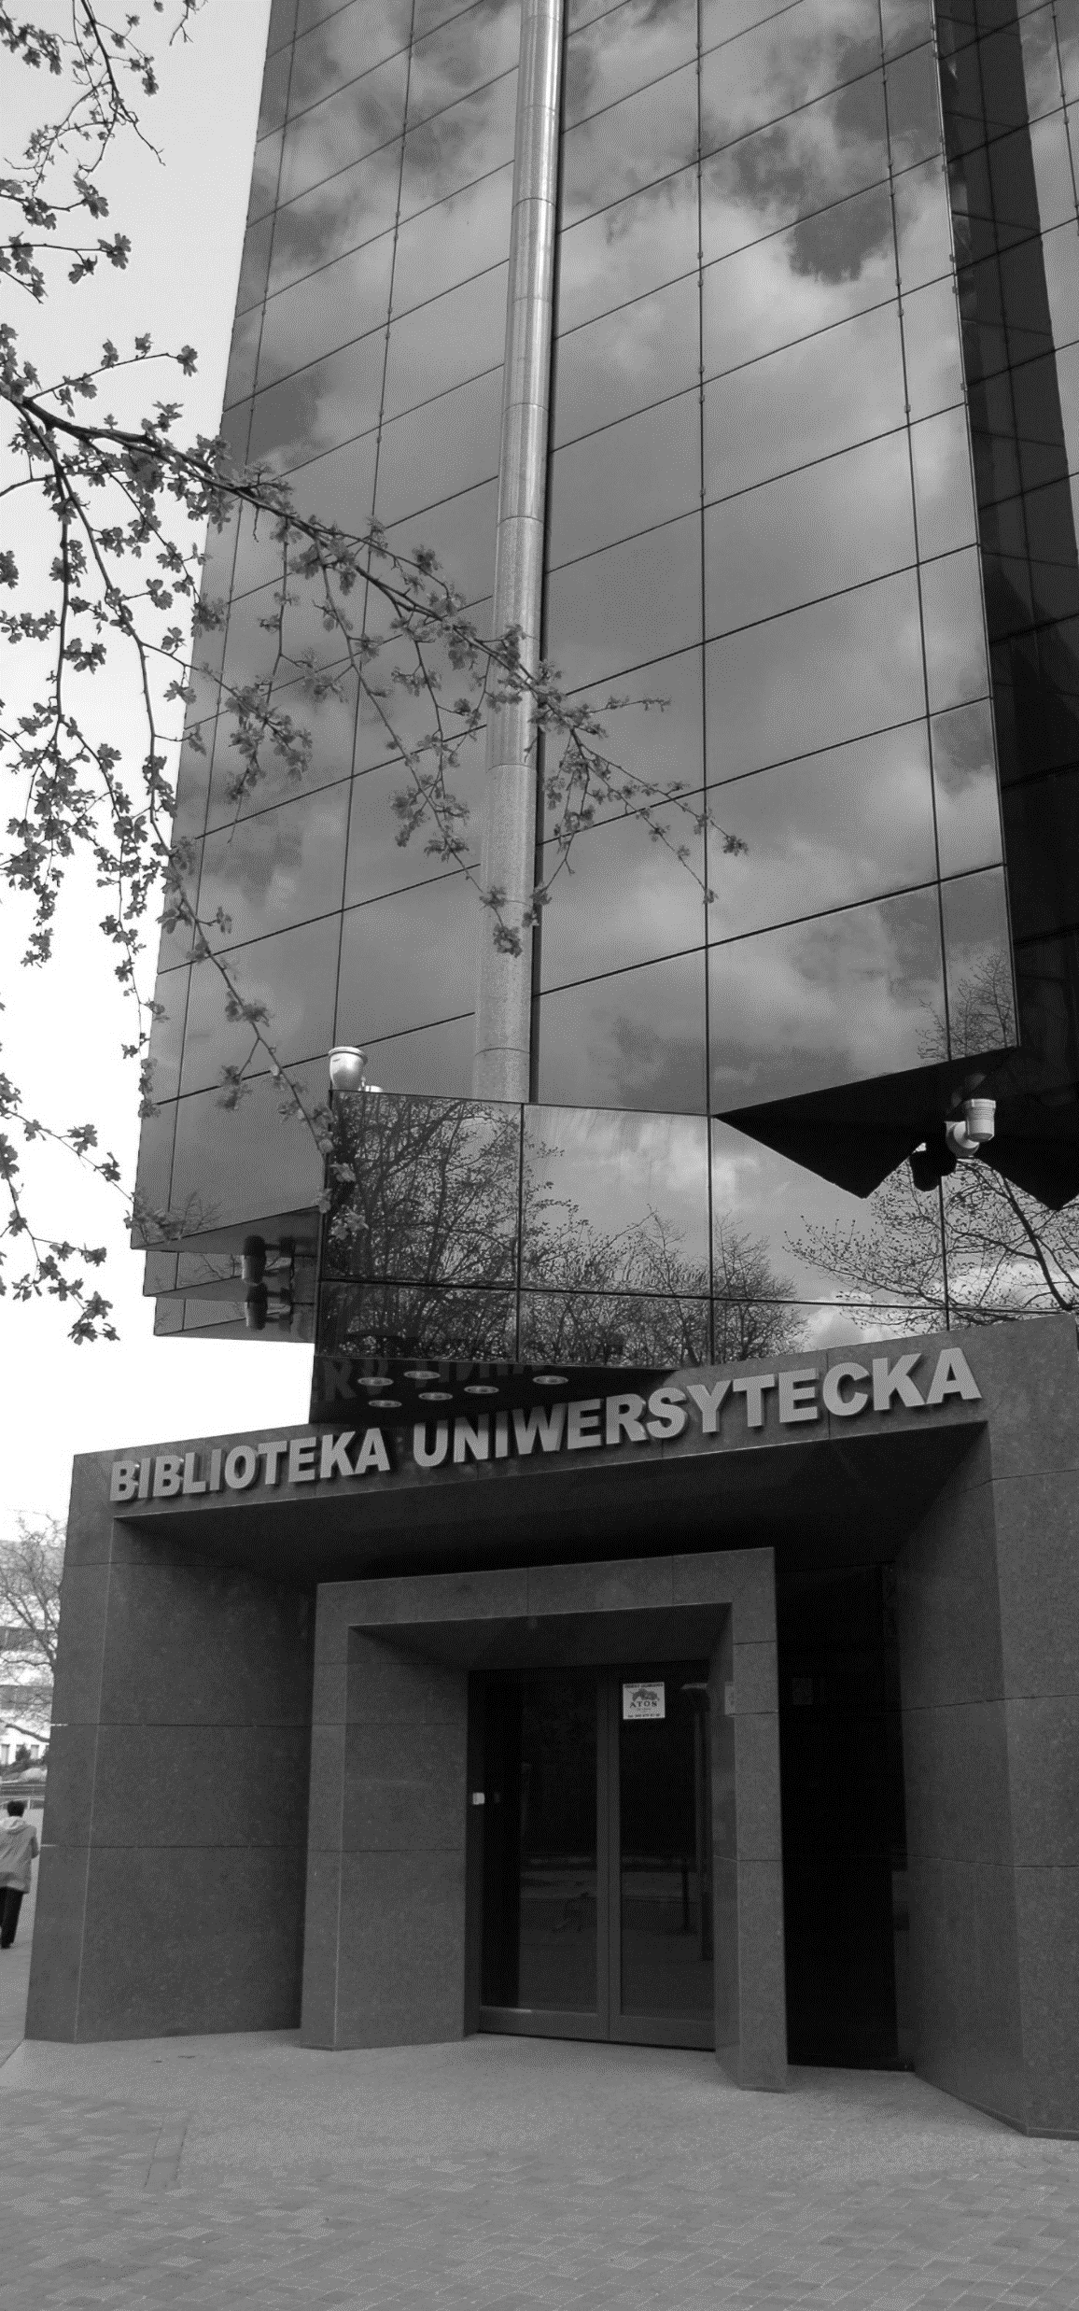


Library Directory
2022/2023

Slide 2
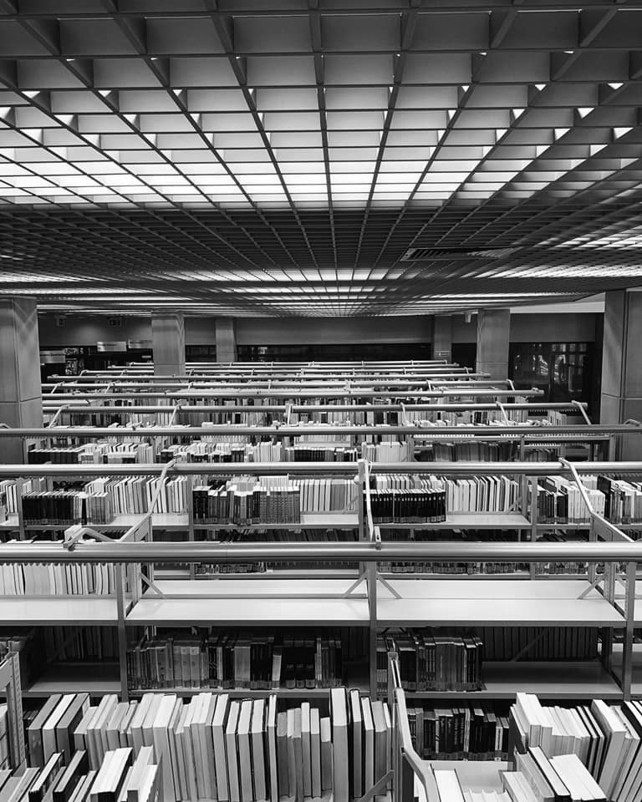

The University of Lodz library (BUŁ)
The University of Lodz Library has been operating since 1945, together with the University. It is a research and a public library. Its collections amount to about 2.5 million items. It has universal collections of books, particularly in the fields of knowledge represented at the University of Lodz - Humanities, History, Economy and Finance, Social nad Natural Sciences, and Law.
The Library delivers books and journals in printed and electronic versions. The library network of the University of Lodz is the Main Library (BUŁ) and the libraries of individual Faculties.
During the academic year, BUŁ is open
from Monday to Saturday from 8 a.m. till 8 p.m.

Slide 3
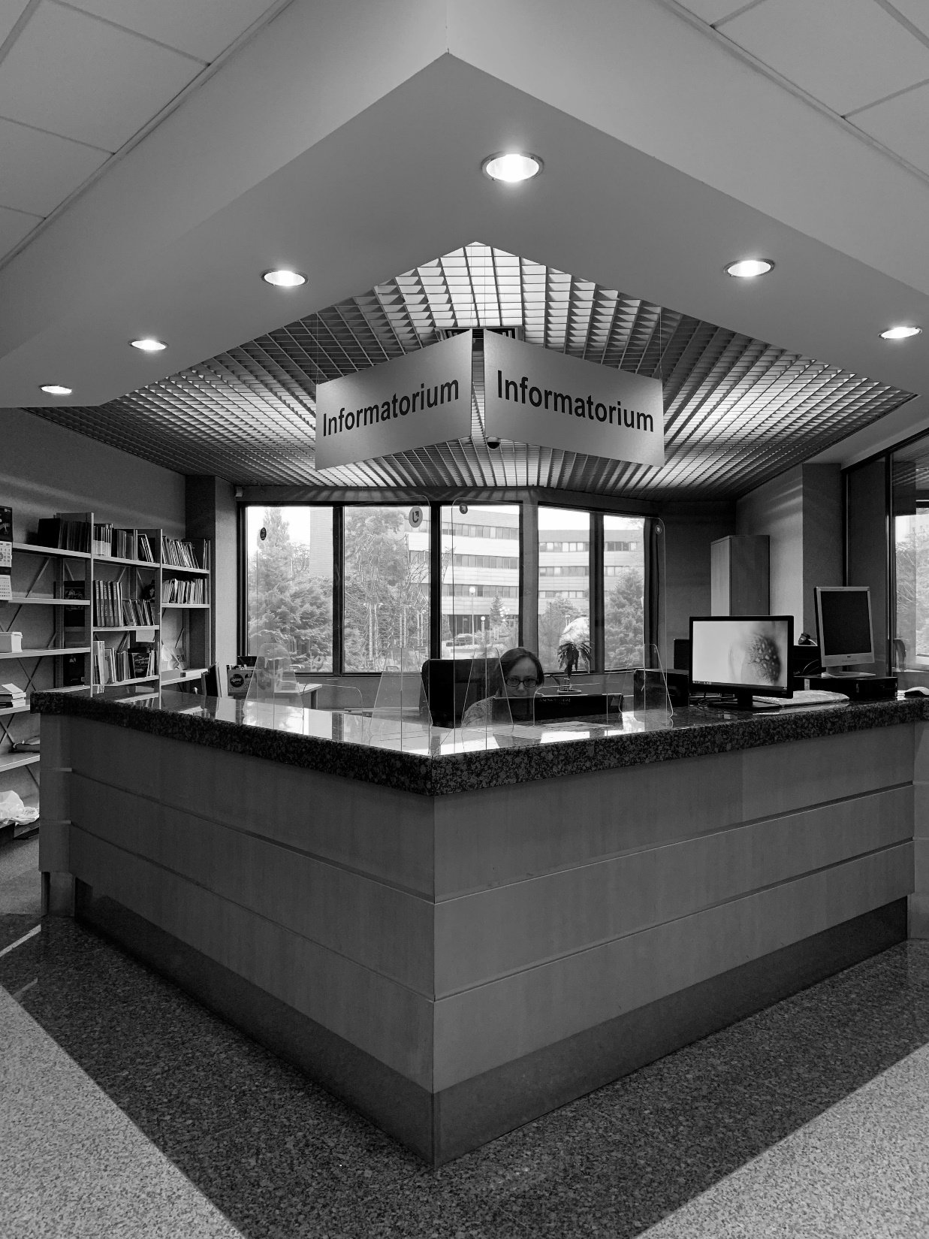
informatorium
Informatorium is located on the ground floor, to the left of the entrance to BUŁ.
Employees of the Scientific Information and Bibliometric Analysis Department work there. They answer questions related to:
the library services,
searching for books and journals, printed and electronic ones.
The service of printing from memory sticks and computer terminals is also available here.

Slide 4
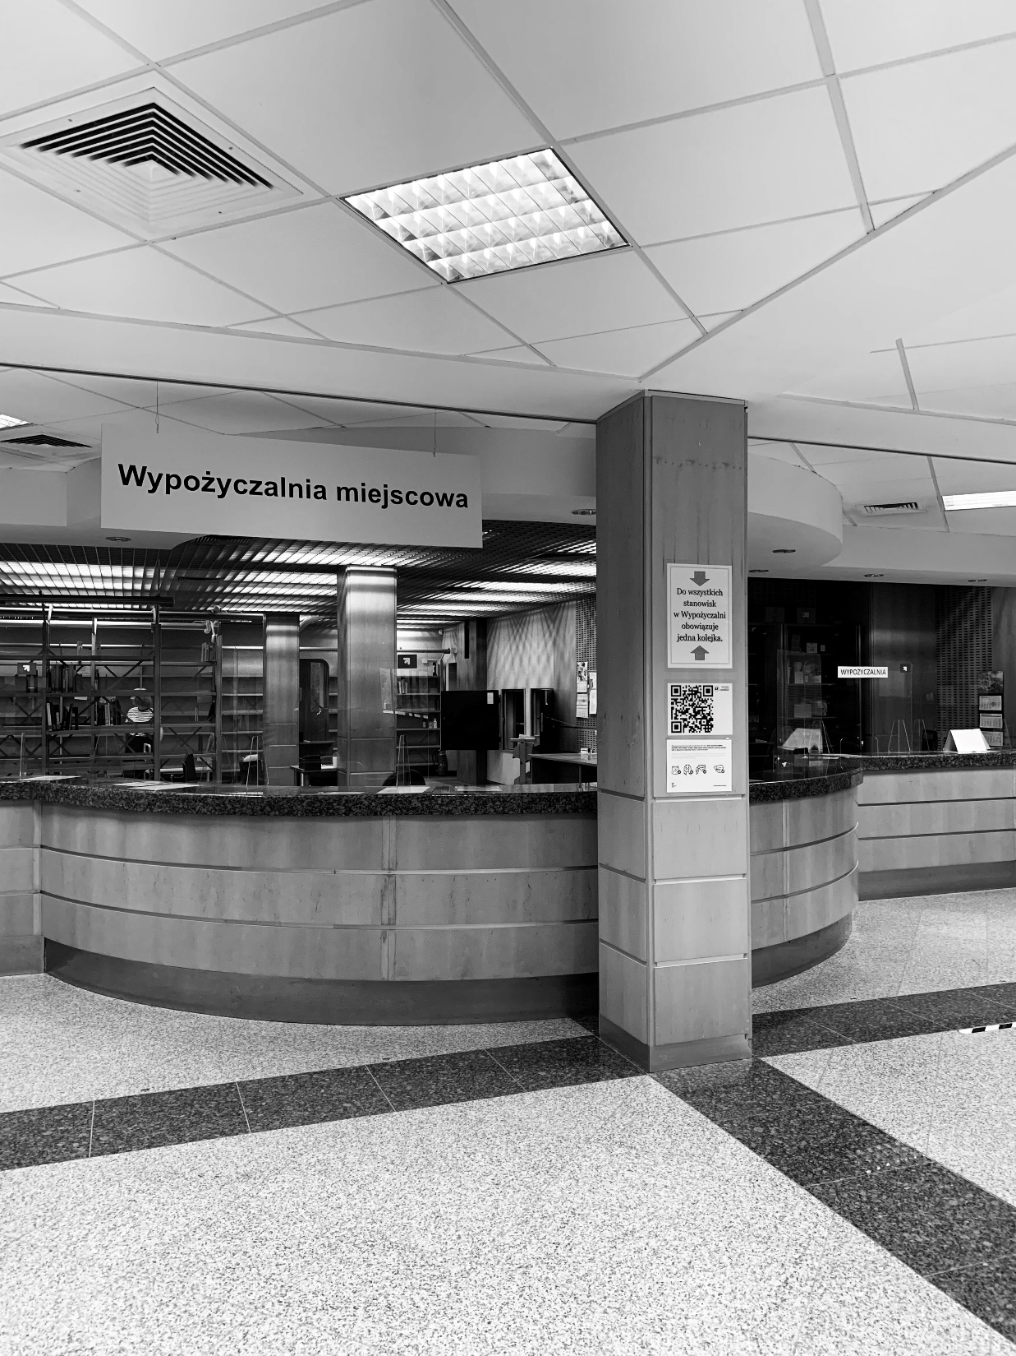
Lending Department
The Lending Department is located on the ground floor. You can register to the Library here. To do it, you need an identity card and a student ID, which will be activated as a library card.
In the Lending Department, orders for books from the closed stacks for home borrowing and their returns are carried out.
Books to borrow home can be also ordered to be picked up from the Book Locker.

Slide 5

circulation rules
Orders for books can be placed from home using the reader's account in the Library Catalog.
Every student of the University of Lodz can borrow 10 books - each for 2 months.
You can obtain additional extention three times, provided that the book is not reserved:
twice on your own by logging into your library account,
the third time by coming to the Lending Department with books.

Slide 6
circulation Rules
Books from the closed stacks are ordered electronically via the reader's account in the Library Catalog, where you will find following descriptions:
„zbiory do wypożyczeń (księgozbiór magazynowy)” you can order a book to be sent to the Lending Department and the Book Locker,
„zbiory do korzystania na miejscu (księgozbiór magazynowy)” you can order a book or
a journal to be sent to the Main Reading Room, the Reading Room of Historical Collection or to the 2nd floor of the Open Access area.

Slide 7
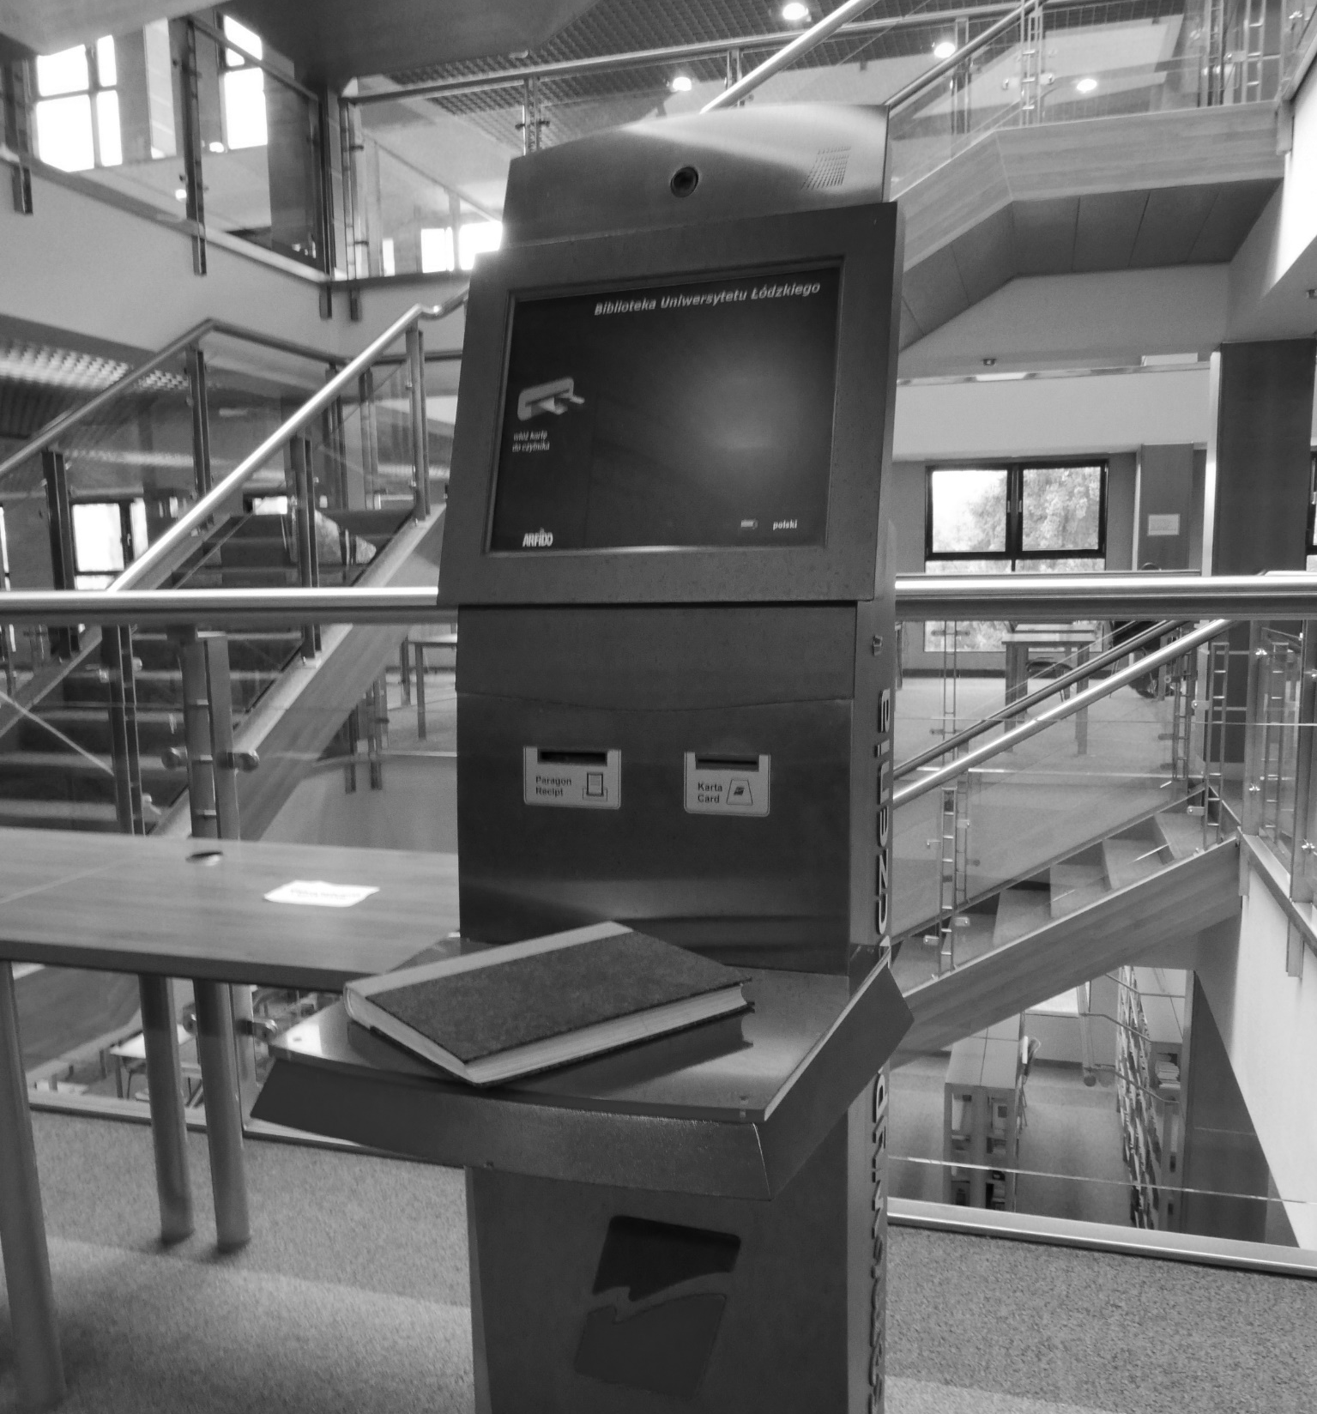
circulation rules
Books from the Open Access area cannot be ordered electronically! You have to find them by yourself on the shelves. In the Library Catalog you will find the following descriptions:
„wolny dostęp zbiory do korzystania na miejscu” – for red-labelled items, which are available only on the spot.
„wolny dostęp zbiory do wypożyczeń” -
for blue-labelled items, which you can borrow home.
You can borrow books using the self-loan machines, which can be found on each floor of the Open Access area.
After the Library's opening hours, you can order books from the Open Access area to be picked up from the Book Locker!

Slide 8
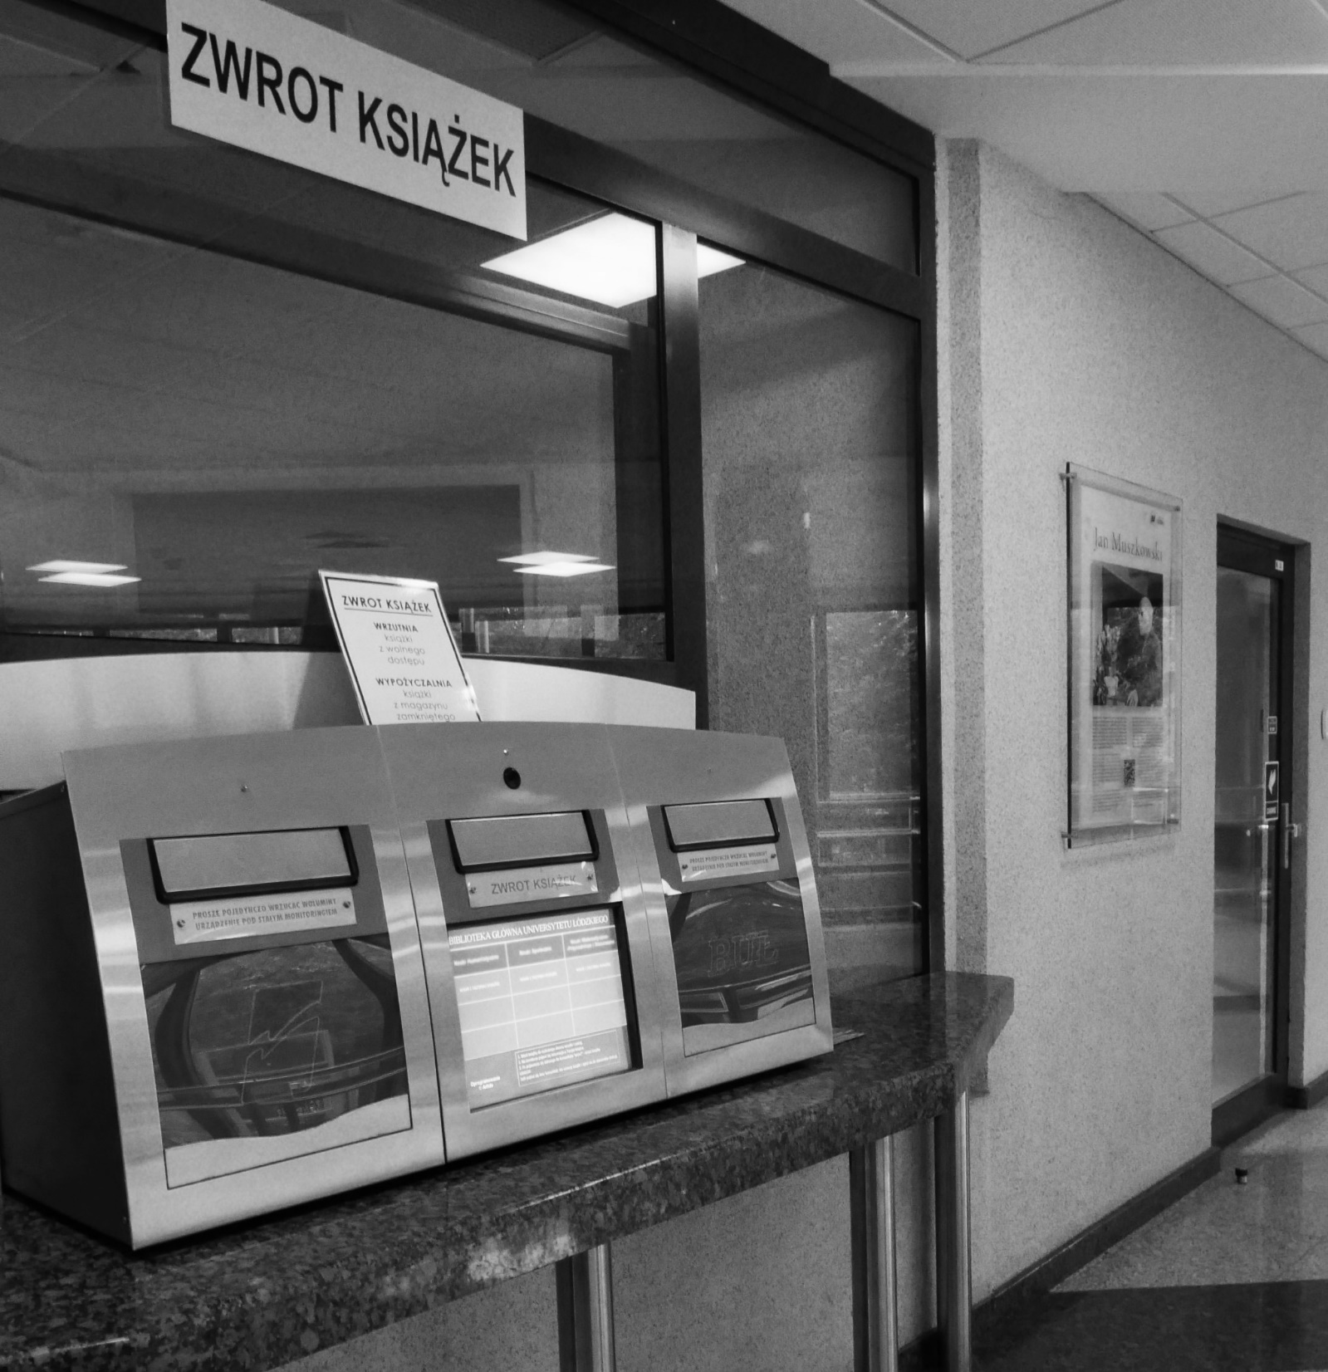
Circulation rules
The books can be returned to:
the Lending Department,
the returning machine, „wrzutnia”, which is located on the ground floor near the elevators. Only books from the Open Access area can be returned there. Using the machine always wait for the green light on the display.
- the Book Locker.

Slide 9
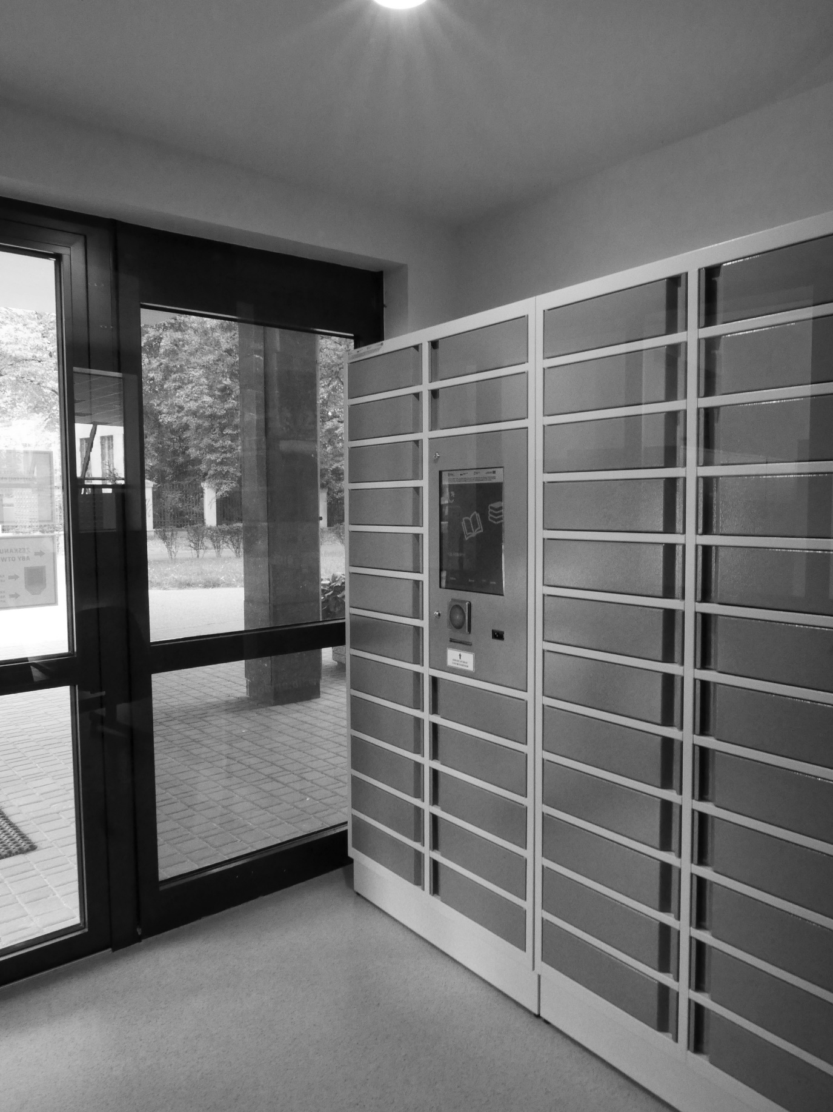
Book locker
You can find the Book Locker in the older part of the Library building, near Narutowicza street.
To use the Book Locker, you need to scan the student ID, which you should have previously registered as
your library card.
In the Book Locker, you can borrow books (you need to order them first) and return them.

Slide 10

v
The Library website www.lib.uni.lodz.pl
Here you will find information about the University of Lodz Library
and entries to the Library Catalog and Multisearcher as well.
The website also provides access to the Virtual Assistant communication platform. You can chat with a consultant during the Library's opening hours.

Slide 11
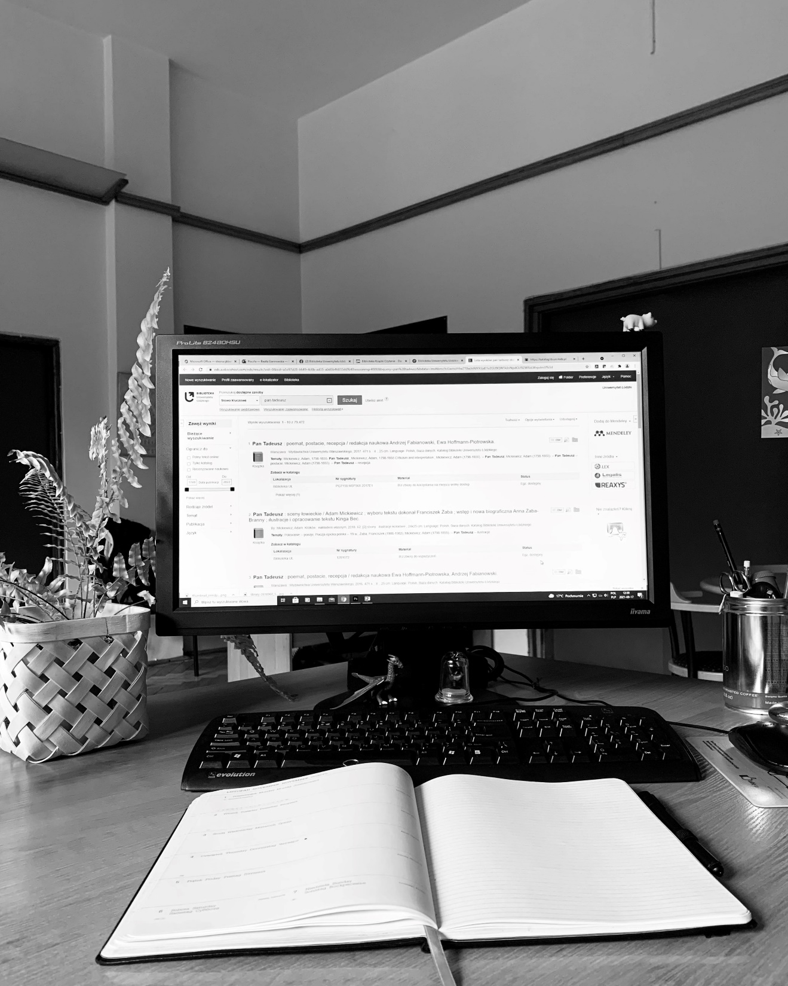
Searching materials
The Library Catalog – searches printed books and journals, allows you to place orders and manage your library account. If there is no book or journal from previous years in it, you should look for them in the digital card catalogs that are available on the website of BUŁ.
multisearcher – searches the library's resources - electronic, printed and open access resources.

Slide 12
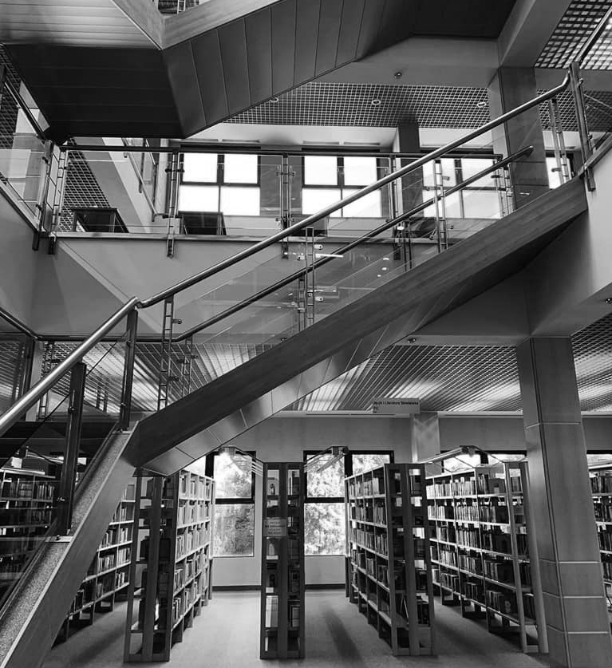
Open acces area
In the new part of the building of BUŁ books are available in the Open Access area. These are mainly the newest collections, divided according to the Classification of the Library of Congress.
There you can find books which in the Library Catalog have a call number consisting of letters and figures, e.g.: BF31.C65165 2009E1, and in the field "location" the inscription „Księgozbiór
w wolnym dostępie". The first letter of the call number directs you to the appropriate part of the Open Access area - its detailed plan can be found in the Informatorium and on each floor.

Slide 13
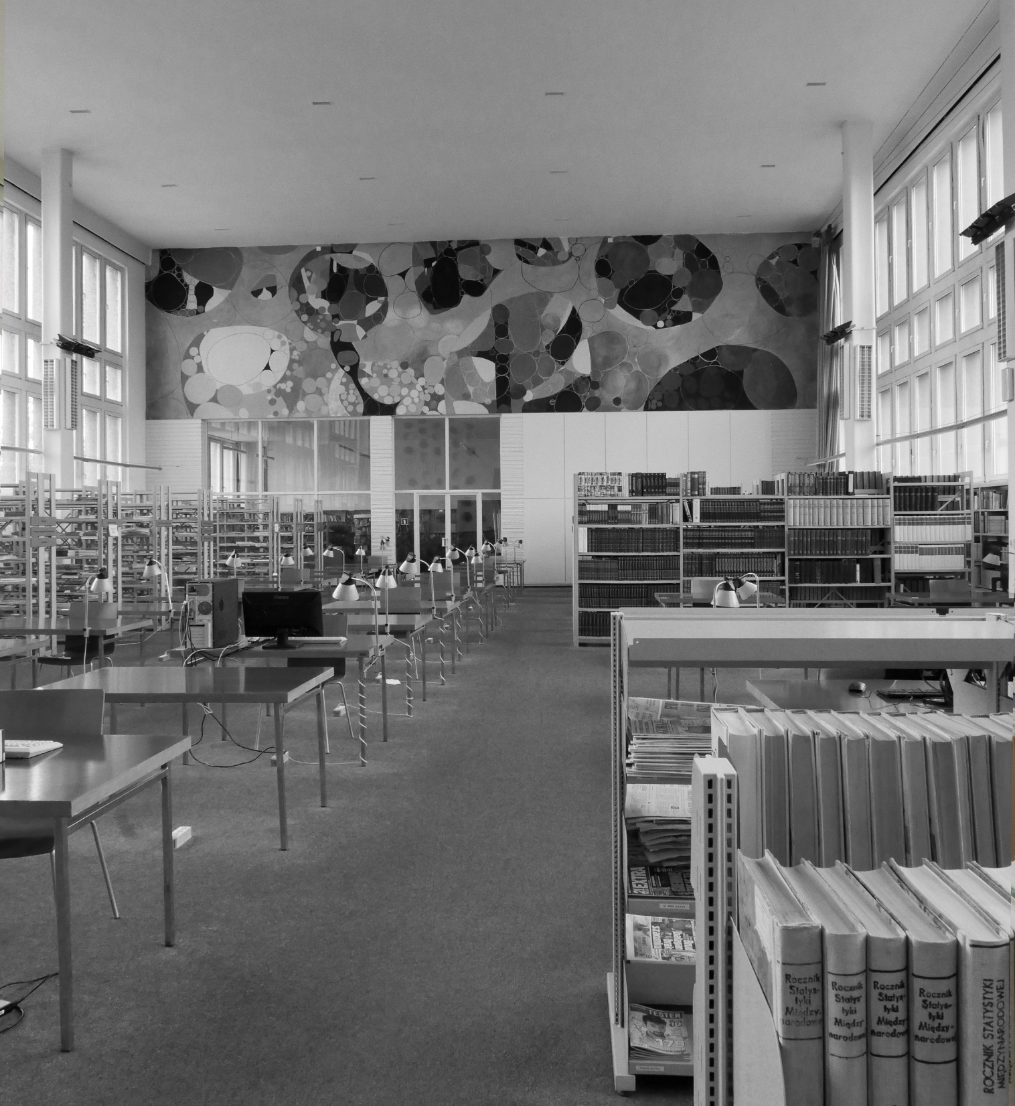
Reading room
of historical collection
And the main reading room
In both reading rooms you can read:
books,
periodicals,
microfilms
and other documents.

Slide 14
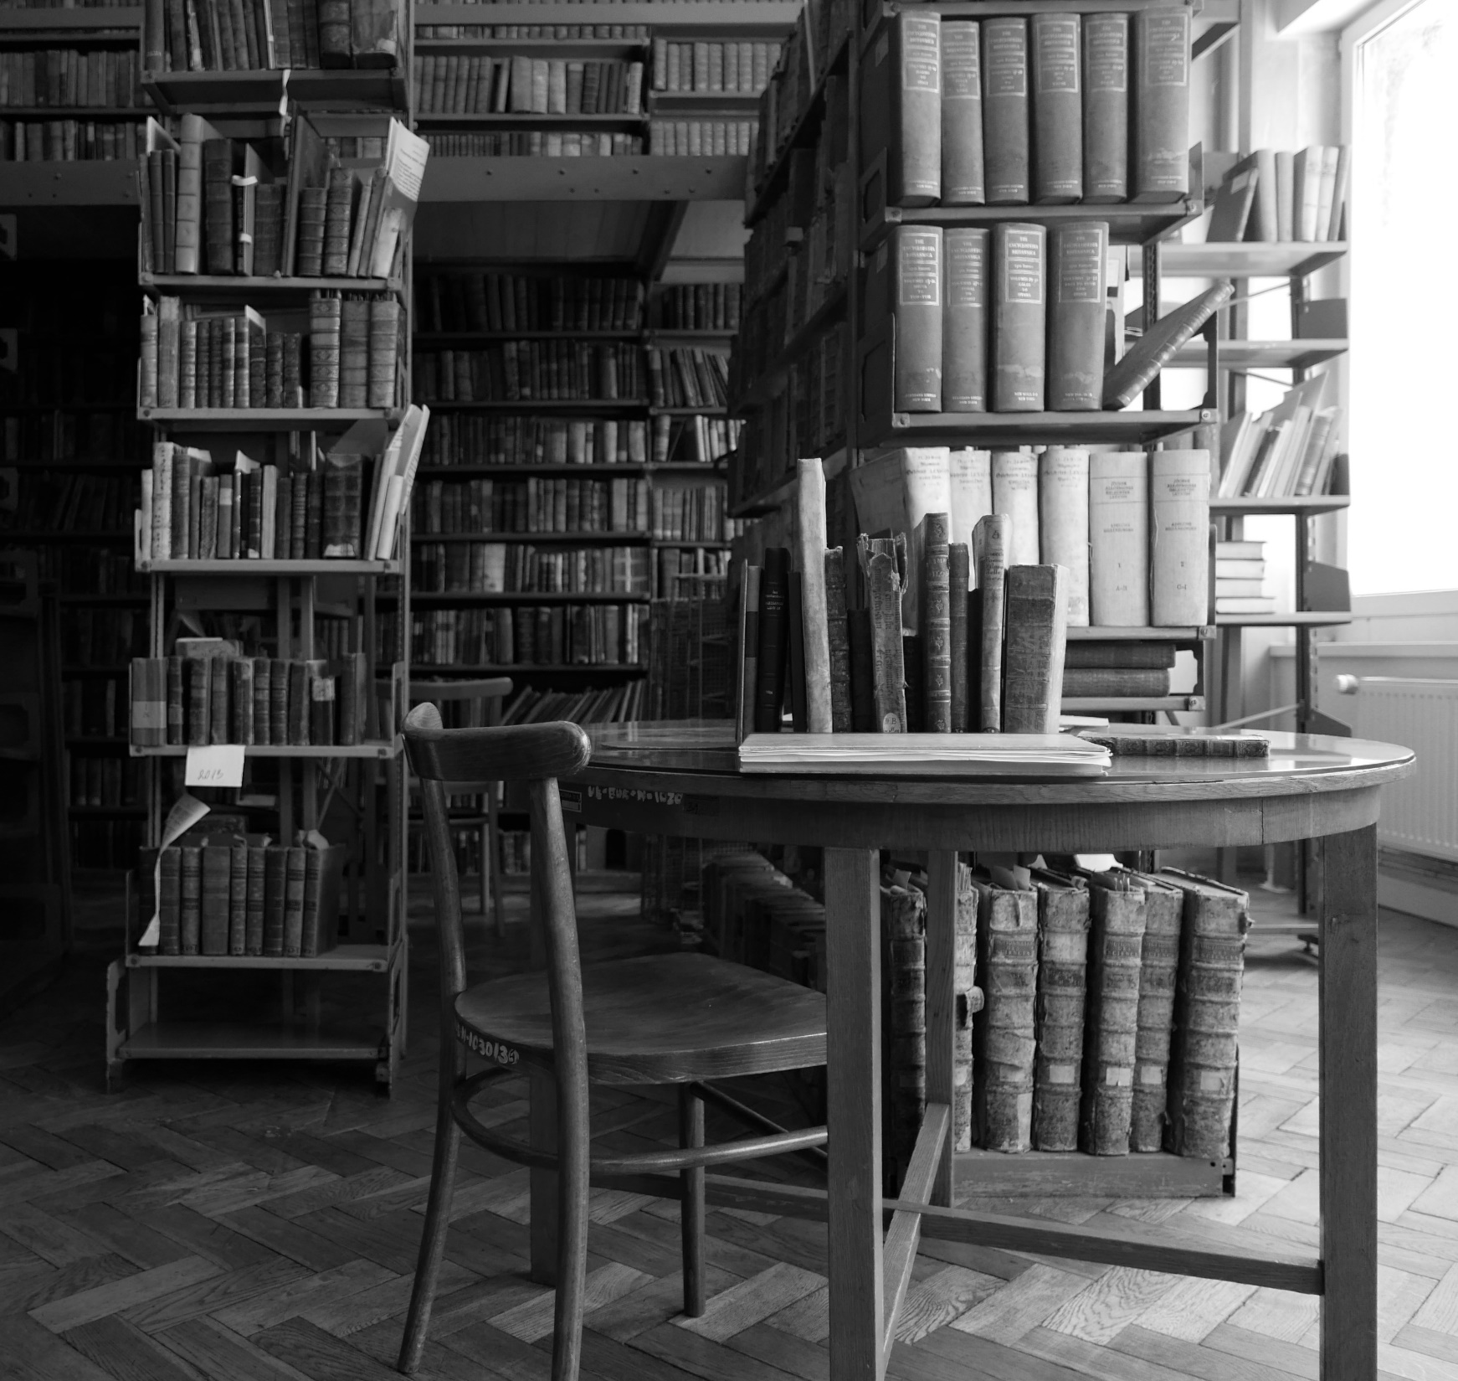
Special collections
The Special Collection Department collects valuable items. You can use them in the Reading Room of the Special Collection Department only on the spot.
Old Prints Collection:
includes materials from the first European printing presses from the fifteenth century up to the 1800.
Manuscripts Collection:
is home to collections of personal papers, correspondence, and autographs.
Cartography Section:
is home to the majority of University Library's cartographic resources, including atlases, maps, plans and guidebooks.

Slide 15
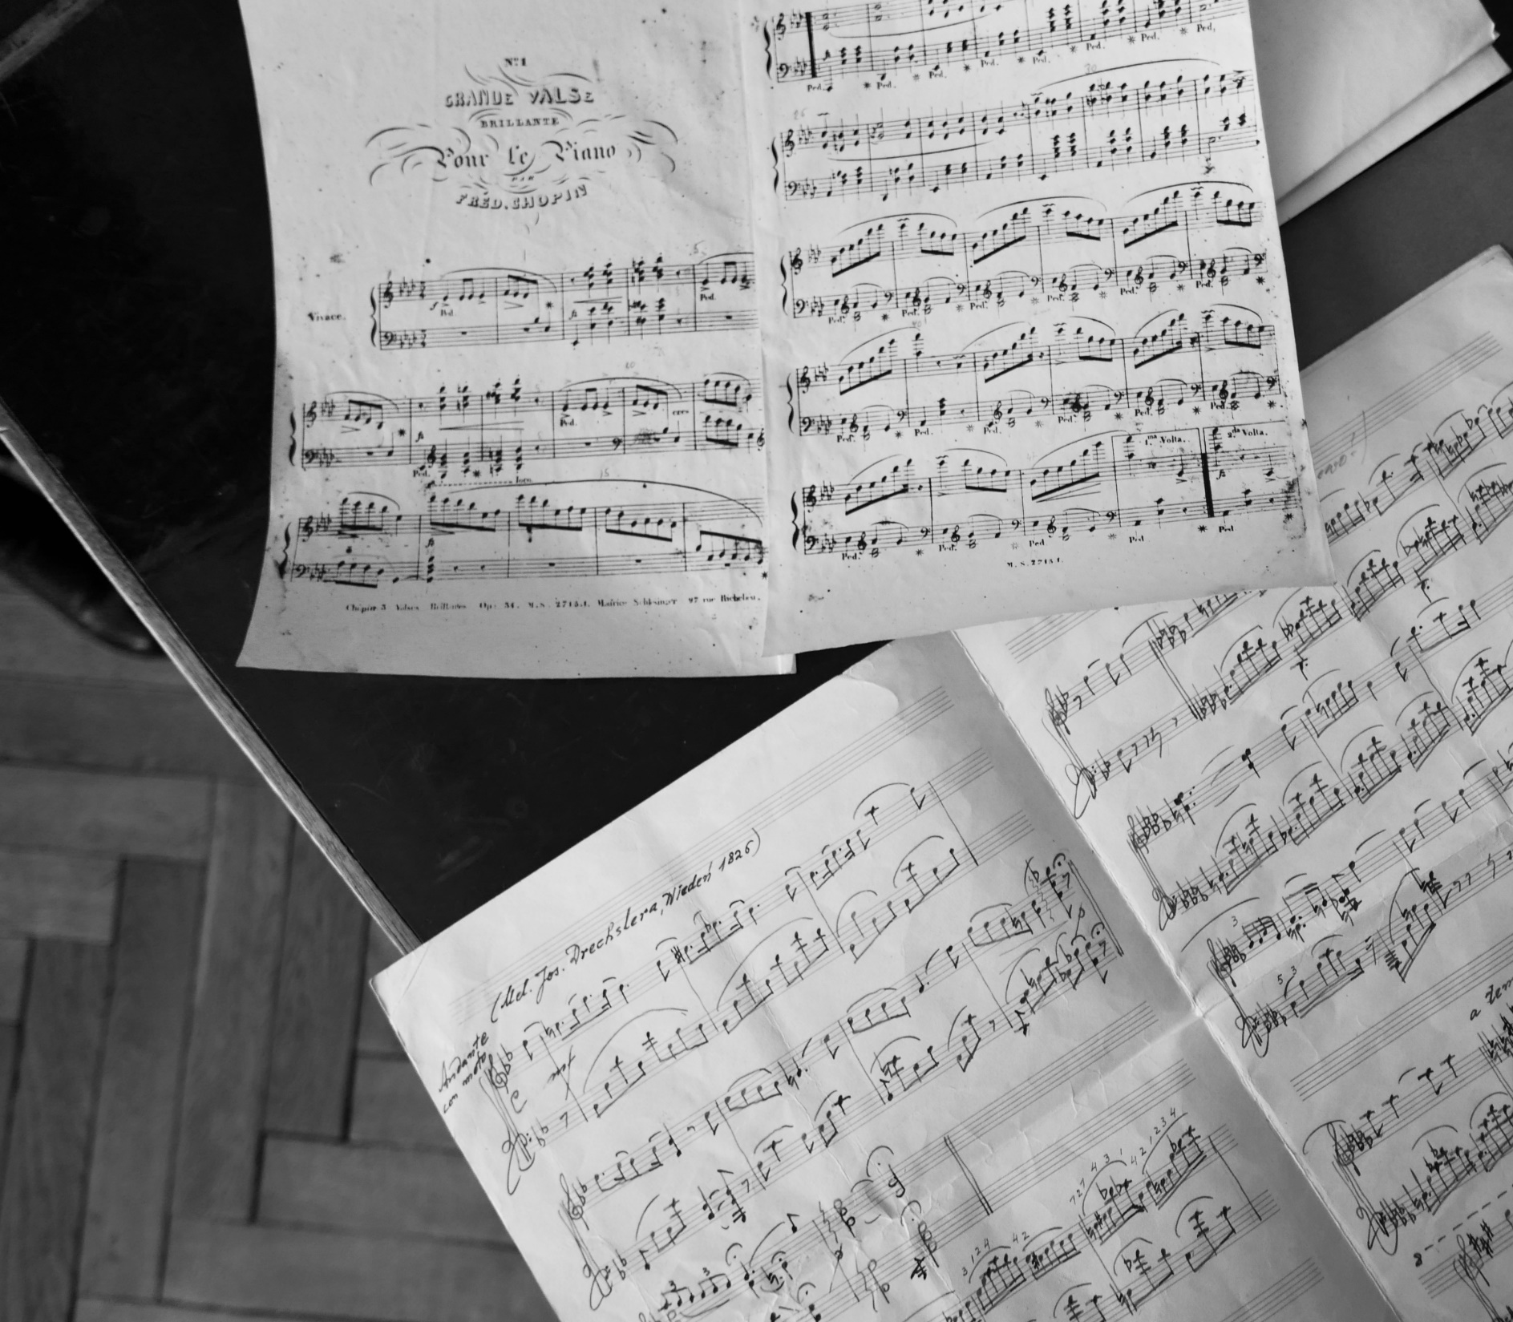
Special collections
Public Relation Documents:
holds posters, directories, calendars, brochures.
Iconography Collection:
includes albums, catalogues of exhibitions, museum guides, graphics, ex-libris, photographs and postcards.
Music Section:
holds reference books on music, music notes, sound recordings and audio-books. There are audio facilities for cassettes, CDs and DVDs.
Rare Books Section:
Rare and valuable books for collectors, which are printed after 1800.

Slide 16
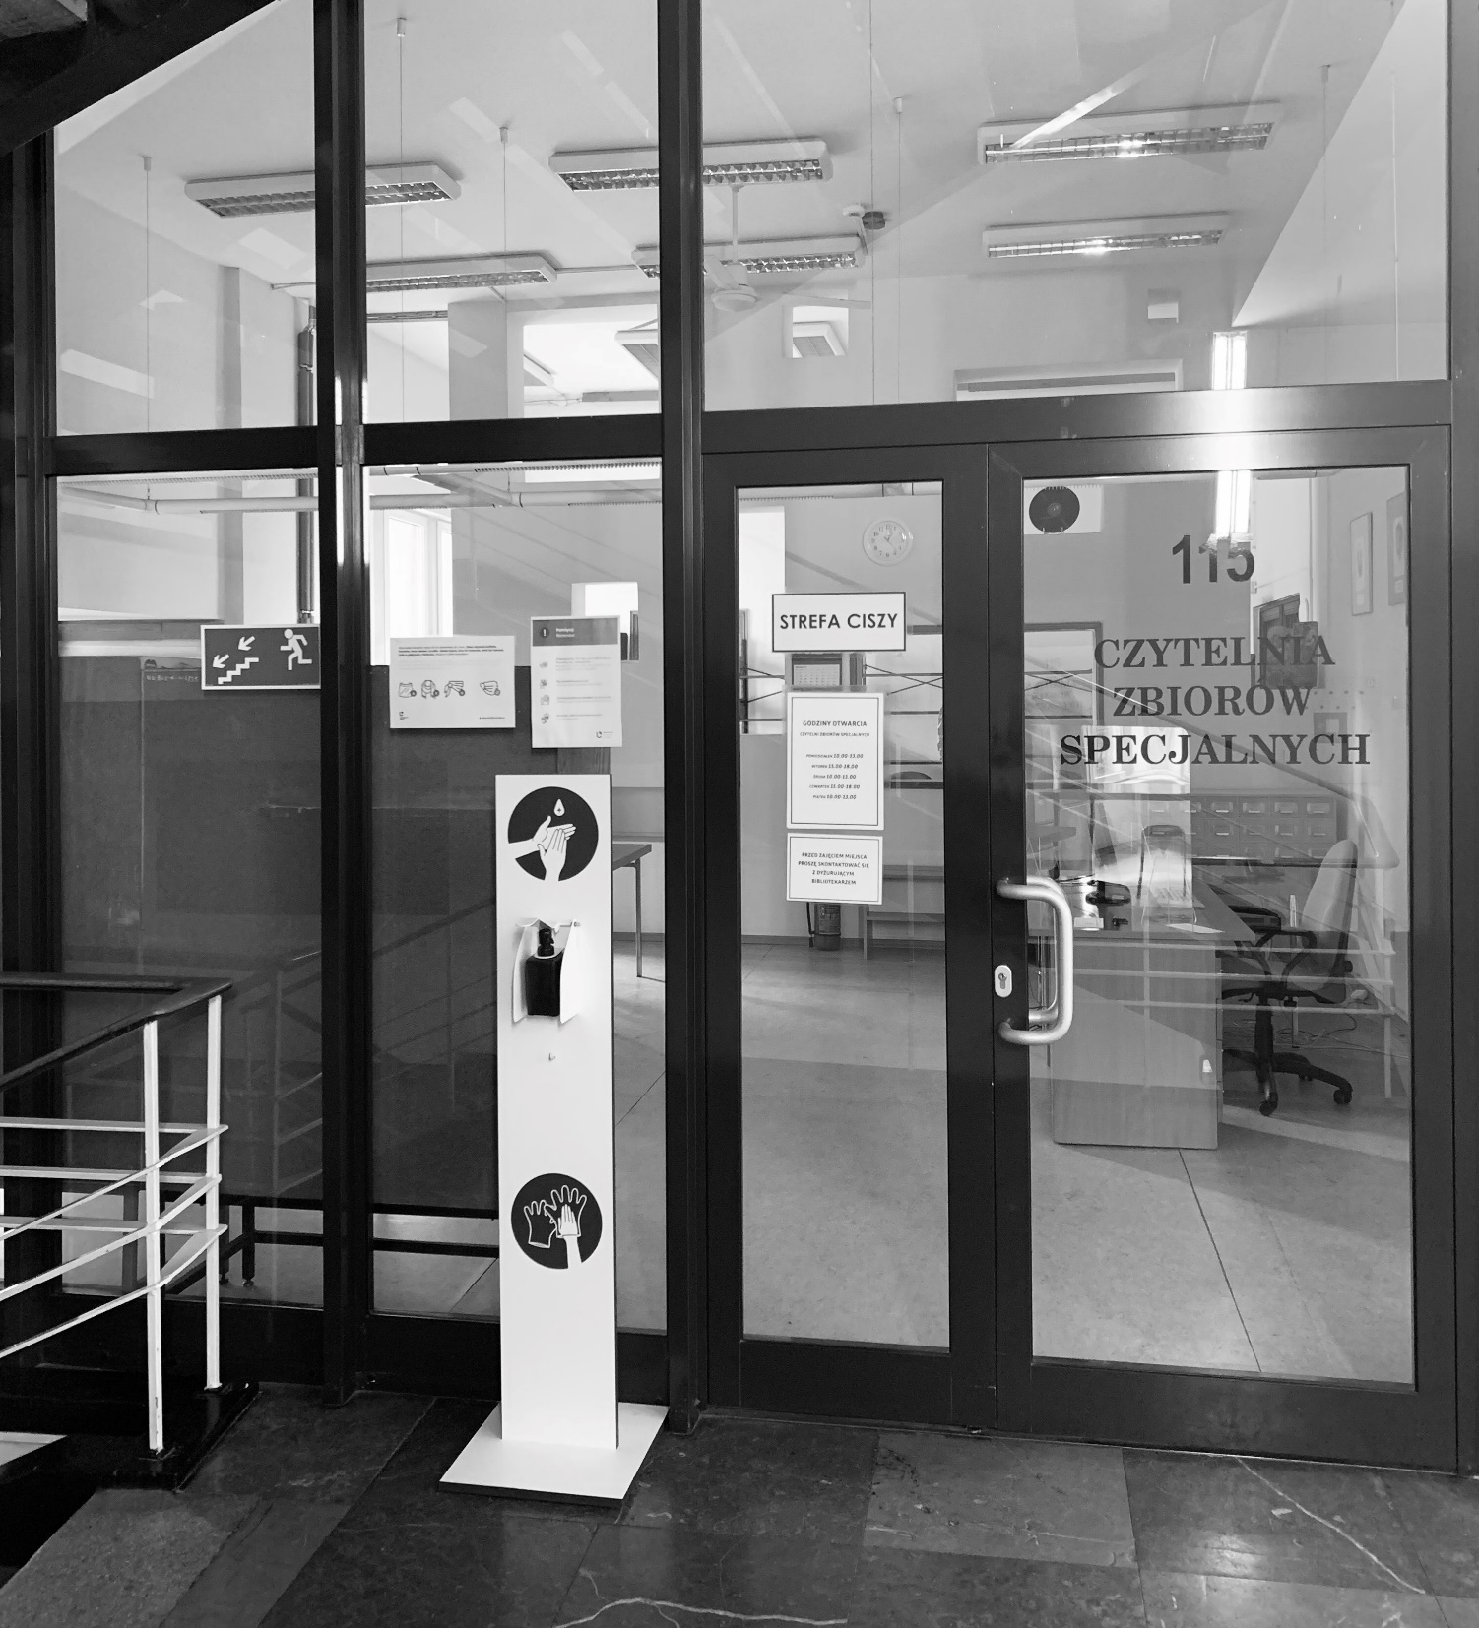
The reading room
Of Special collection
Department
Opening hours:
Monday, Wednesday, Friday: 10.00 am. - 2.00 p.m.
Tuesday, Thursday: 2.00 p.m. - 6.00 p.m.

Slide 17
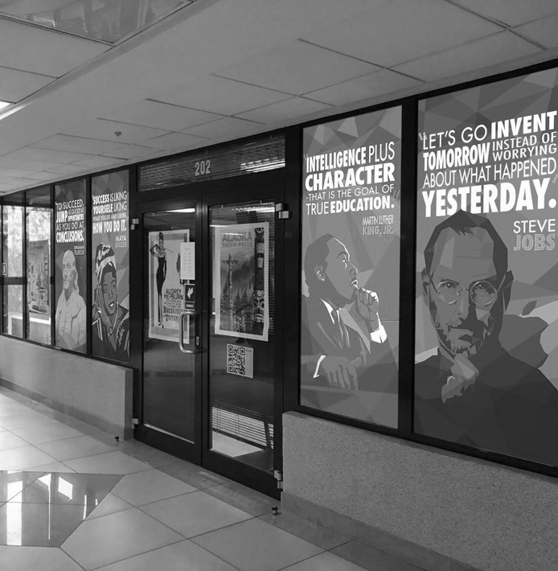
American corner
You can find the American Corner Library on the second floor of the BUŁ building. It provides books, board games and newspapers in English, information about the US economy, history, and culture.
You can search collections available in the American Corner in the Library Catalog (see the „Library Catalog" video).
You can find more information about the events and activities of the AC Library on its FB profile.

Slide 18
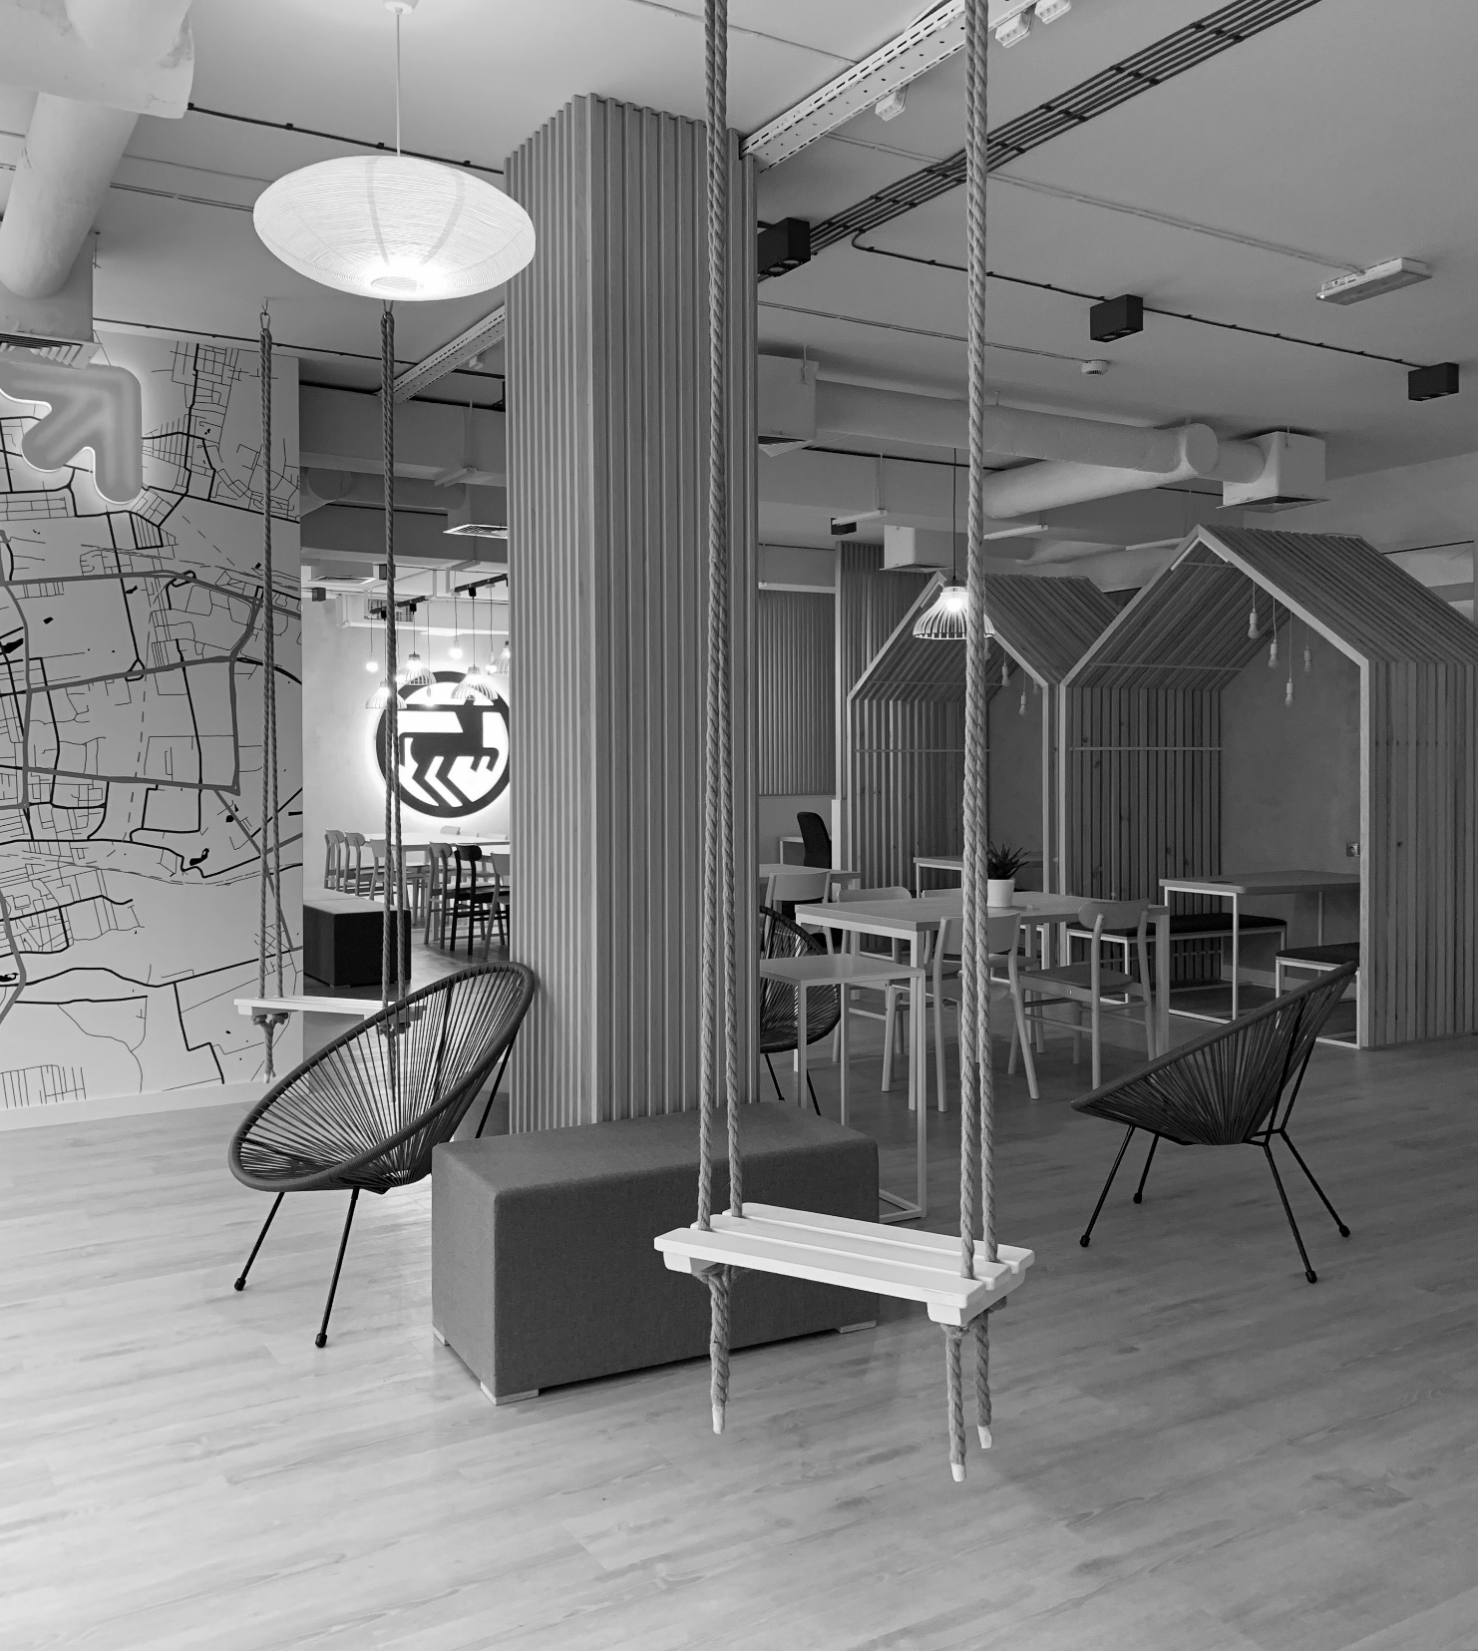
Spaces for individual
and group learning
ROOMS FOR INDIVIDUAL WORK are on the second floor with free access. You can book them through the reader's account in the Library Catalog.
STUDY ROOM FOR A PARENT WITH A CHILD can be found in the hall on the second floor of BUŁ. There are specially adapted furniture, books and educational toys there. It has two workplaces for parents. You can book the place by phone.
The COWORKING ZONE is located on the ground floor of BUŁ on the left side of the Lending Department. It is available to all the users during the Library's opening hours.

Slide 19
v
Library regulations
Before visiting BUŁ, you are required to read the rules and regulations governing it. They can be found on the website www.lib.uni.lodz.pl in the „Regulamin” tab.

Slide 20
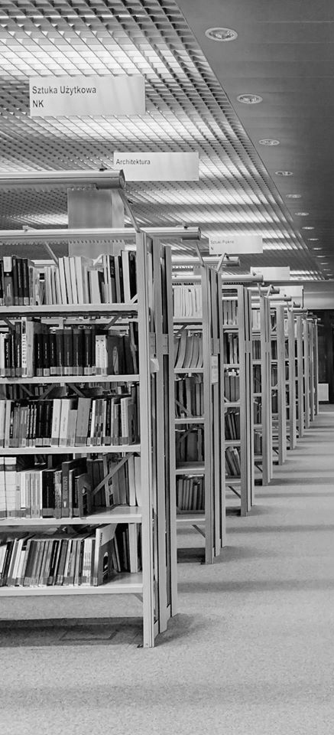

See you in the Library!

